Slide 1

¿Cómo somos? - Describing People in Spanish
Notes:
Created from: https://docs.google.com/document/d/1udUMraMwpQudSJDv9O3b4eJGKALD-EvICL6jdcDp-80/edit

Slide 2

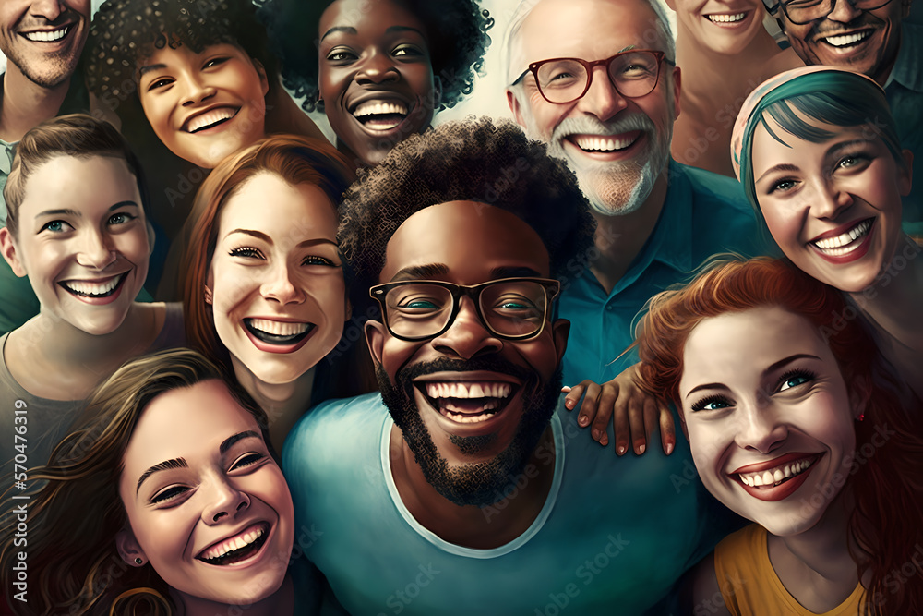
Introduction: ¿Cómo somos?
Welcome to our lesson on describing people in Spanish!
We'll learn vocabulary and grammar to talk about:
Who people are
How they look
What their personalities are like
Question: Why is it important to learn how to describe people?

Slide 3

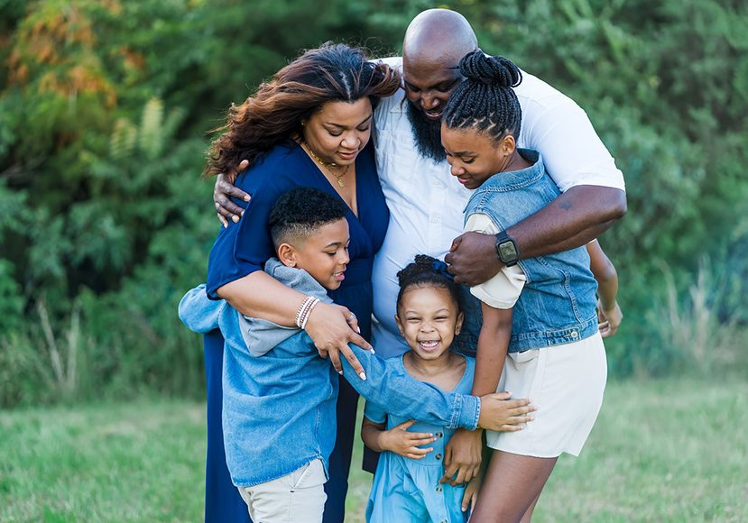
Nouns for People
Let's start with nouns to identify people:
Family members: madre, padre, hermano, hermana
Professions: maestro, doctor, estudiante
Relationships: amigo, novio, vecino
Can you think of other nouns to describe people you know?

Slide 4

Practice: Recognizing People Nouns
Match the Spanish noun to its English meaning:
1. abuela
2. primo
3. jefe
4. compañero de clase
a. grandmother
b. cousin
c. boss
d. classmate
How many did you get right?

Slide 5
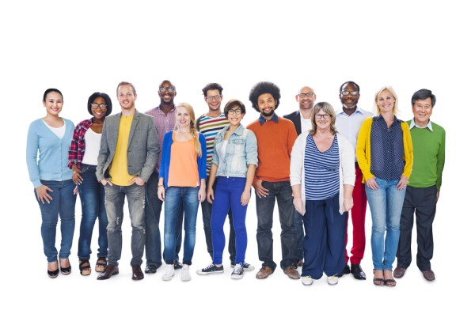
Adjectives for Appearance
Adjectives to describe how people look:
Height: alto (tall), bajo (short)
Build: delgado (thin), gordo (fat)
Hair color: rubio (blonde), moreno (dark-haired)
Eye color: azul (blue), verde (green), marrón (brown)
Can you describe yourself using these adjectives?

Slide 6
Practice: Providing Appearance Adjectives
Fill in the blank with an appropriate adjective:
1. Mi hermano es muy _____ (he's 6'2")
2. La niña tiene ojos _____ (like the sky)
3. El hombre es _____ (he weighs 250 lbs)
Share your answers with a partner!

Slide 7
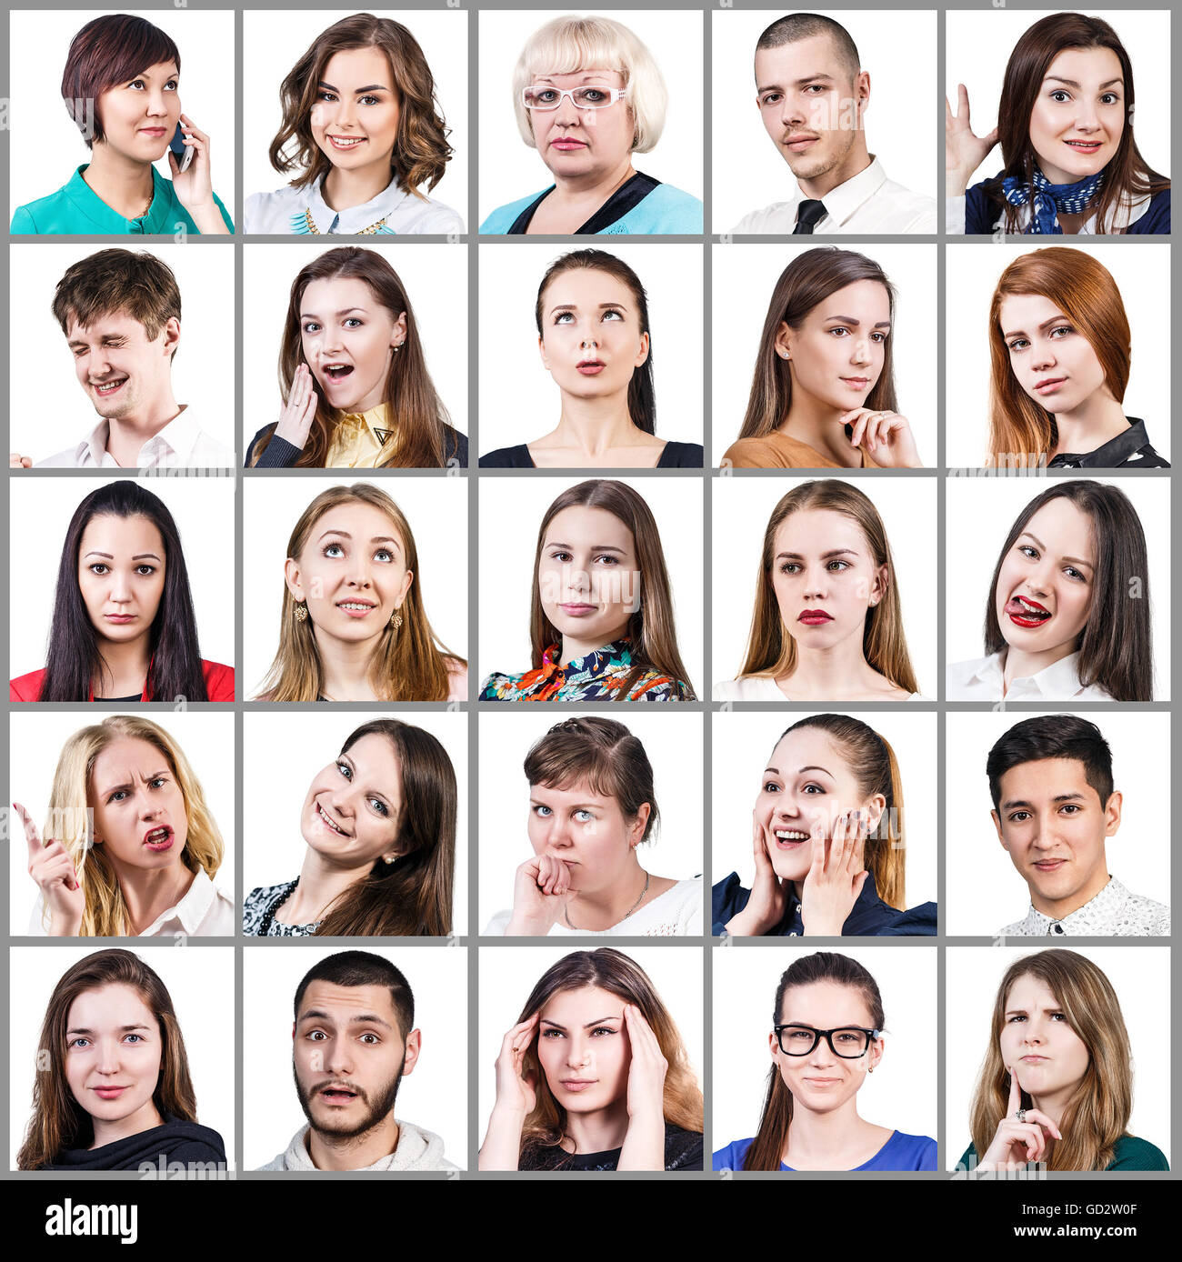
Personality Adjectives
Words to describe personality traits:
inteligente (intelligent)
divertido (fun)
serio (serious)
amable (kind)
perezoso (lazy)
Question: Which of these traits do you think is most important in a friend?

Slide 8
Practice: Recognizing Personality Adjectives
Choose the correct personality adjective:
1. She always helps others: a) egoísta b) amable
2. He never wants to do homework: a) trabajador b) perezoso
3. She knows a lot about many subjects: a) inteligente b) tonto
Discuss your choices with a classmate.

Slide 9
Subject Pronouns
Subject pronouns in Spanish:
yo (I)
tú (you - informal)
él (he), ella (she)
usted (you - formal)
nosotros/nosotras (we)
vosotros/vosotras (you all - informal, used in Spain)
ellos/ellas (they)
ustedes (you all - formal)
When do we use subject pronouns in Spanish?

Slide 10
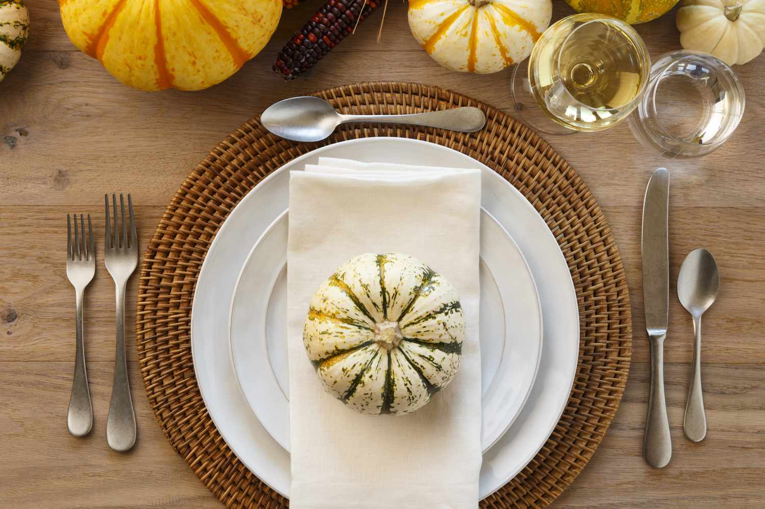
Tú vs. Usted
Tú: informal "you" for friends, family, children
Usted: formal "you" for strangers, elders, authority figures
Examples:
¿Cómo estás tú? (How are you? - to a friend)
¿Cómo está usted? (How are you? - to a teacher)
When would you use tú or usted with different people in your life?

Slide 11
Greetings and Introductions
Informal:
Hola, ¿qué tal? (Hi, how's it going?)
Mucho gusto en conocerte. (Nice to meet you.)
Formal:
Buenos días, ¿cómo está? (Good morning, how are you?)
Encantado/a de conocerle. (Pleased to meet you.)
Practice these greetings with a partner!

Slide 12
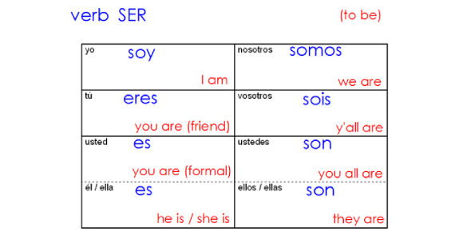
The Verb "Ser" (To Be)
Present tense conjugation of "ser":
yo soy
tú eres
él/ella/usted es
nosotros/as somos
vosotros/as sois
ellos/ellas/ustedes son
We use "ser" for describing permanent characteristics.
Can you make a sentence using "ser" to describe yourself?

Slide 13
Practice: Selecting "Ser" Forms
Choose the correct form of "ser":
1. Nosotros _____ estudiantes. (somos/son)
2. Tú _____ muy inteligente. (es/eres)
3. Ellas _____ altas. (son/sois)
Check your answers with a partner.

Slide 14
Practice: Providing "Ser" Forms
Fill in the blank with the correct form of "ser":
1. Yo _____ de España.
2. Ustedes _____ mis mejores amigos.
3. Él _____ un buen maestro.
Share your completed sentences with the class!

Slide 15
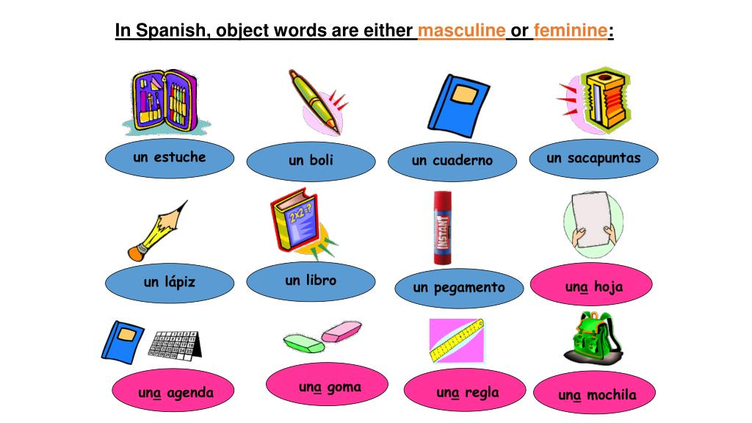
Gender in Spanish
In Spanish, nouns are either masculine or feminine
Masculine nouns often end in -o: el libro, el perro
Feminine nouns often end in -a: la casa, la gata
Exceptions exist: el día (m), la mano (f)
Why do you think Spanish has gendered nouns?

Slide 16
Noun-Adjective Agreement
Adjectives must agree with the noun they describe:
El chico alto (The tall boy)
La chica alta (The tall girl)
For adjectives ending in -o:
Masculine: -o, Feminine: -a
For adjectives ending in -e or a consonant:
Same for both: un hombre inteligente, una mujer inteligente
Can you think of more examples?

Slide 17

Forming Plurals
To make nouns plural:
Add -s to words ending in a vowel: libro → libros
Add -es to words ending in a consonant: papel → papeles
Adjectives follow the same rules:
alto → altos, alta → altas
inteligente → inteligentes
Practice: Make these words plural: casa, lápiz, azul

Slide 18
Gender and Number: Putting It All Together
Let's categorize words:
1. el estudiante inteligente
2. la profesora amable
3. los libros interesantes
4. las mujeres altas
Identify the gender and number for each noun and adjective.
How do the adjectives change to match the nouns?

Slide 19
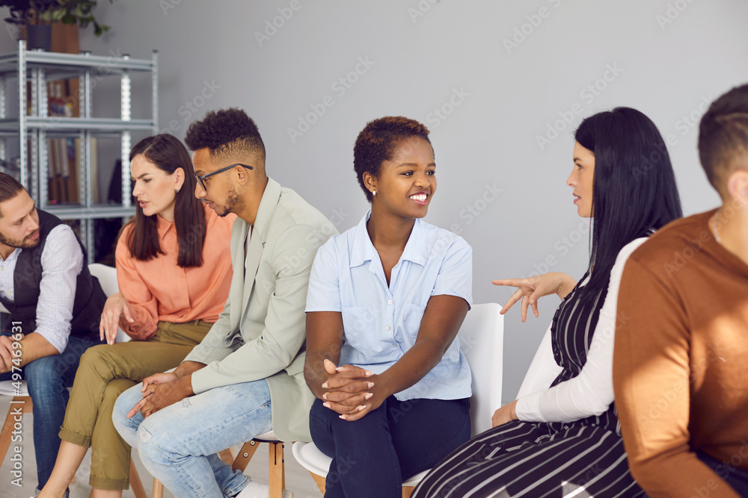
Review: Describing People
We've learned:
Nouns for people
Adjectives for appearance and personality
Subject pronouns and "ser"
Gender and number agreement
Can you describe someone in your family using what we've learned?

Slide 20
Final Practice: ¡Descríbete!
Write a short paragraph about yourself in Spanish:
Use at least 3 nouns
Include 2 appearance adjectives
Use 2 personality adjectives
Incorporate the verb "ser"
Share your description with a classmate and see if they can translate it!

Slide 21
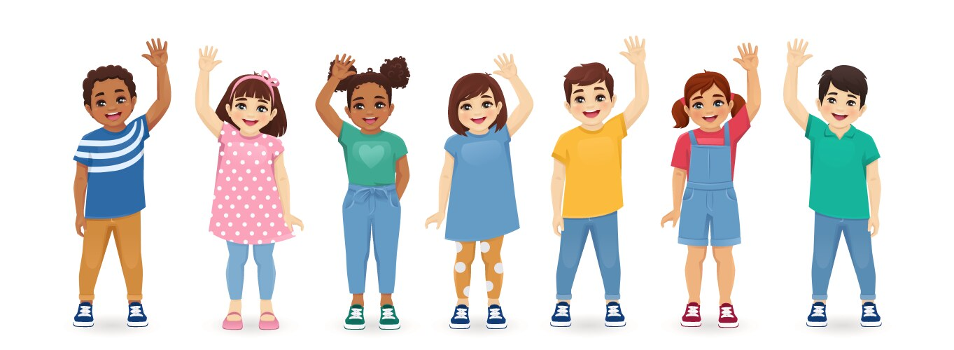
¡Hasta luego!
Great job learning about describing people in Spanish!
Remember to practice using these new words and concepts.
Next time, we'll learn more about daily activities and routines.
Any final questions about today's lesson?

