Slide 1

Introduction to Spanish: Vocabulary and Basic Concepts
Notes:
Created from: https://docs.google.com/document/d/1udUMraMwpQudSJDv9O3b4eJGKALD-EvICL6jdcDp-80/edit

Slide 2

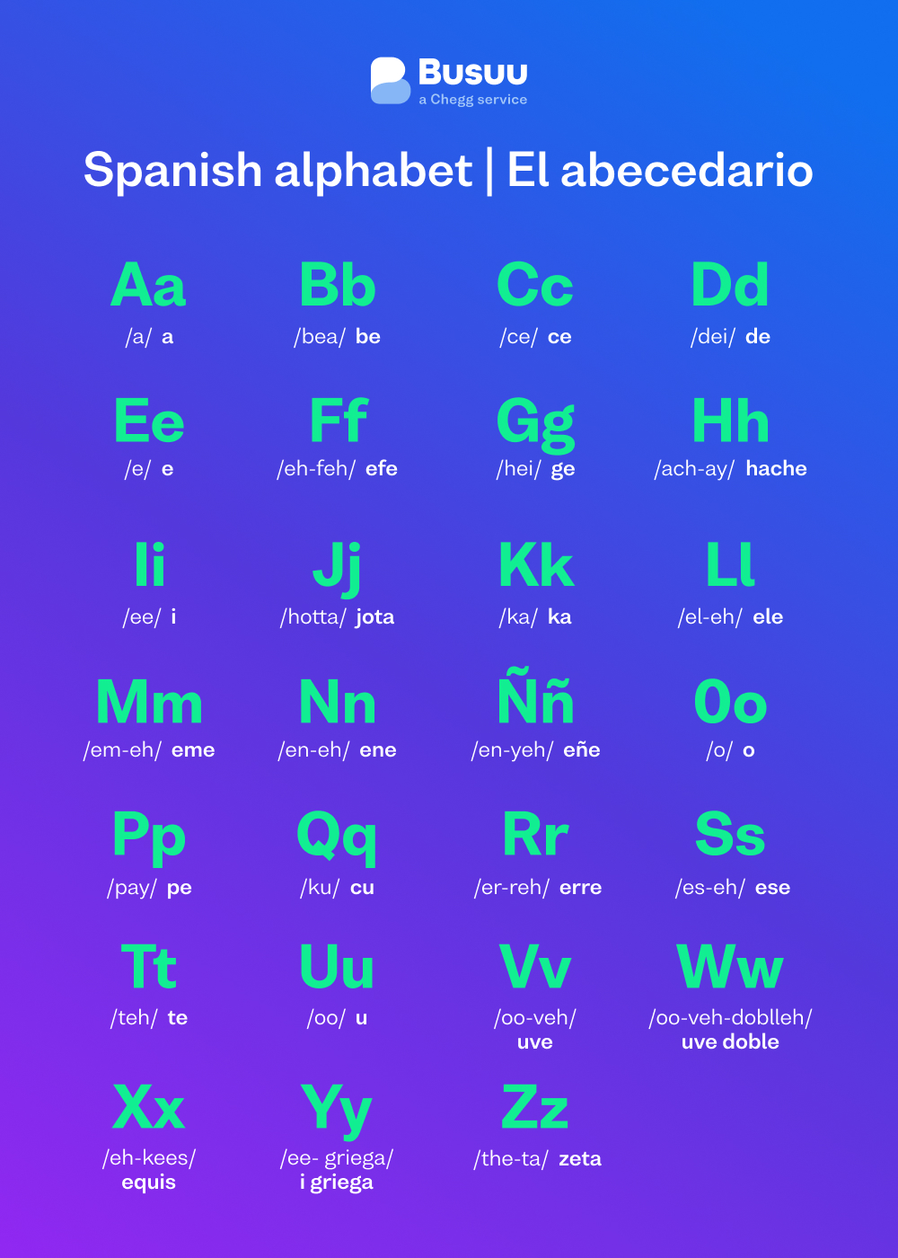
The Spanish Alphabet
27 letters in the Spanish alphabet
Similar to English, with a few differences:
Additional letter: ñ (enye)
ch, ll, and rr are considered letter pairs
Pronunciation varies from English for some letters
Can you name 3 letters that might sound different in Spanish?

Slide 3

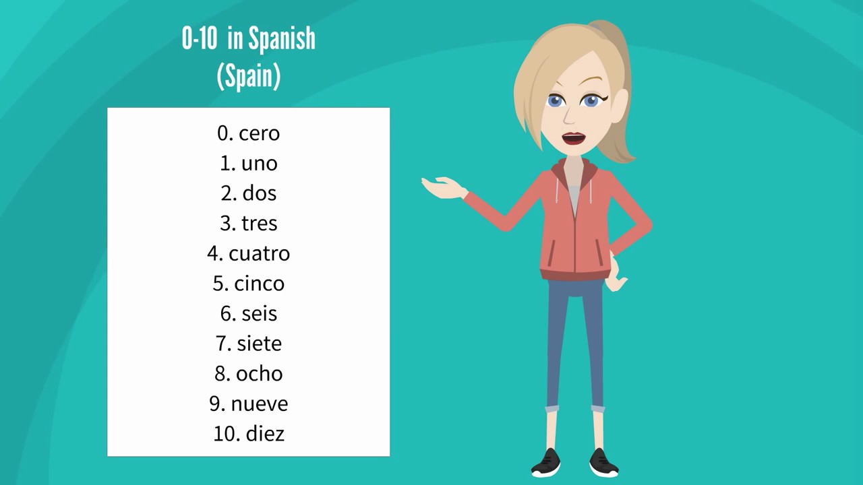
Numbers 0-10 in Spanish
0: cero
1: uno
2: dos
3: tres
4: cuatro
5: cinco
6: seis
7: siete
8: ocho
9: nueve
10: diez
Practice: Count from 0 to 10 in Spanish

Slide 4

Numbers 11-20 in Spanish
11: once
12: doce
13: trece
14: catorce
15: quince
16: dieciséis
17: diecisiete
18: dieciocho
19: diecinueve
20: veinte
Can you spot the pattern for numbers 16-19?

Slide 5
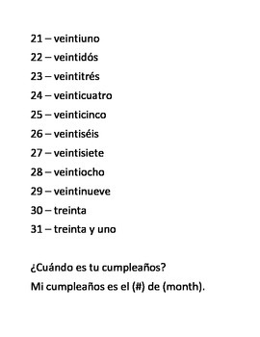
Numbers 21-31 in Spanish
21: veintiuno
22: veintidós
23: veintitrés
...
30: treinta
31: treinta y uno
Notice the pattern: "veinti-" + number for 21-29
After 30, use "y" (and) between tens and ones
How would you say 25 in Spanish?

Slide 6
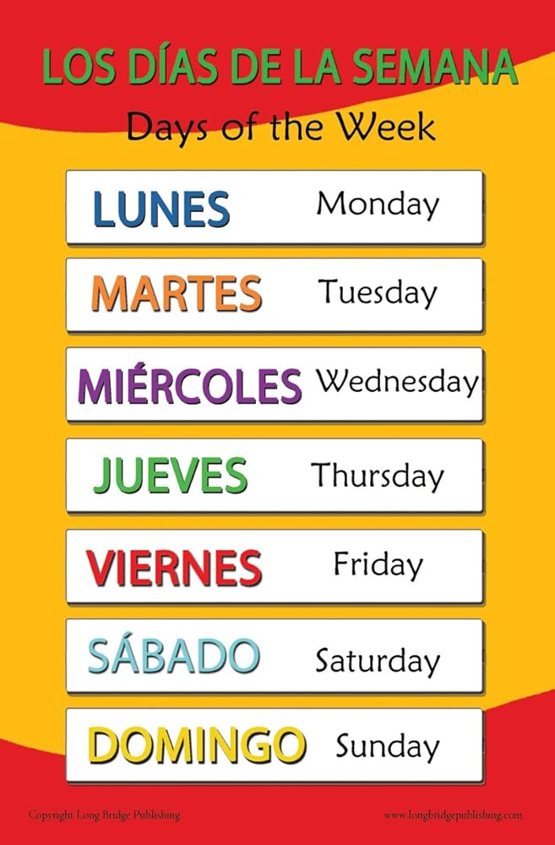
Days of the Week
lunes (Monday)
martes (Tuesday)
miércoles (Wednesday)
jueves (Thursday)
viernes (Friday)
sábado (Saturday)
domingo (Sunday)
Note: Days of the week are not capitalized in Spanish
Which day is your favorite? Can you say it in Spanish?

Slide 7
Months of the Year
enero (January)
febrero (February)
marzo (March)
abril (April)
mayo (May)
junio (June)
julio (July)
agosto (August)
septiembre (September)
octubre (October)
noviembre (November)
diciembre (December)
Like days, months are not capitalized in Spanish

Slide 8
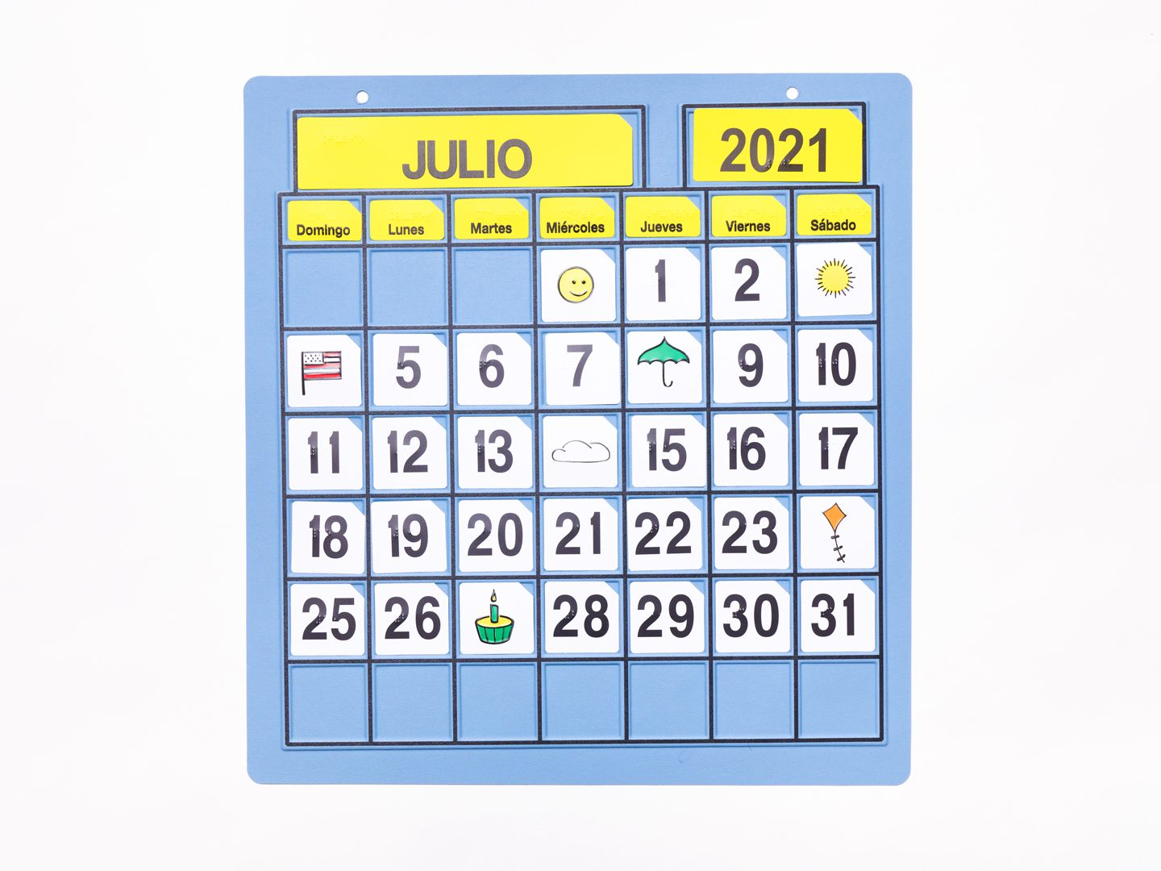
Providing the Date in Spanish
Format: day + de + month + de + year
Example: 15 de mayo de 2023
Use cardinal numbers for days (except first - "primero")
"de" means "of" in this context
Practice: How would you say today's date in Spanish?

Slide 9
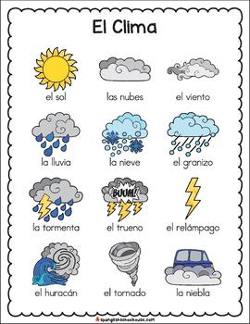
Weather and Seasons
Seasons:
la primavera (spring)
el verano (summer)
el otoño (fall)
el invierno (winter)
Common weather terms:
Hace sol (It's sunny)
Llueve (It's raining)
Nieva (It's snowing)
Hace frío (It's cold)
Hace calor (It's hot)
What's your favorite season? Can you describe its weather in Spanish?

Slide 10
Spanish-Speaking Countries: North and Central America
North America:
Mexico
Central America:
Guatemala
El Salvador
Honduras
Nicaragua
Costa Rica
Panama
Caribbean:
Cuba
Dominican Republic
Puerto Rico (U.S. territory)
Can you locate these countries on a map?

Slide 11
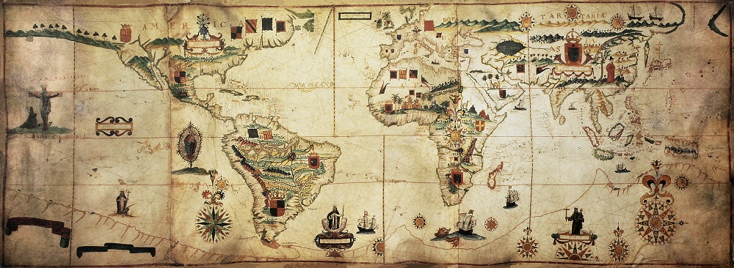
Spanish-Speaking Countries: Europe and Africa
Europe:
Spain
Africa:
Equatorial Guinea
Spanish is also spoken in other African countries, but not as an official language
Did you know Spanish was spoken in Africa? What do you think is the historical reason for this?

Slide 12
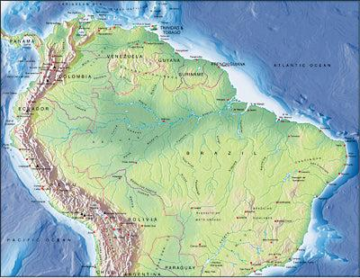
Spanish-Speaking Countries: South America (Part 1)
Colombia
Venezuela
Ecuador
Peru
Bolivia
These countries are located in the northern and western parts of South America
Can you name any famous landmarks or natural features in these countries?

Slide 13
Spanish-Speaking Countries: South America (Part 2)
Chile
Argentina
Uruguay
Paraguay
These countries are in the southern part of South America
Did you know that Spanish isn't the only language spoken in some of these countries? Can you guess what other languages might be used?

Slide 14
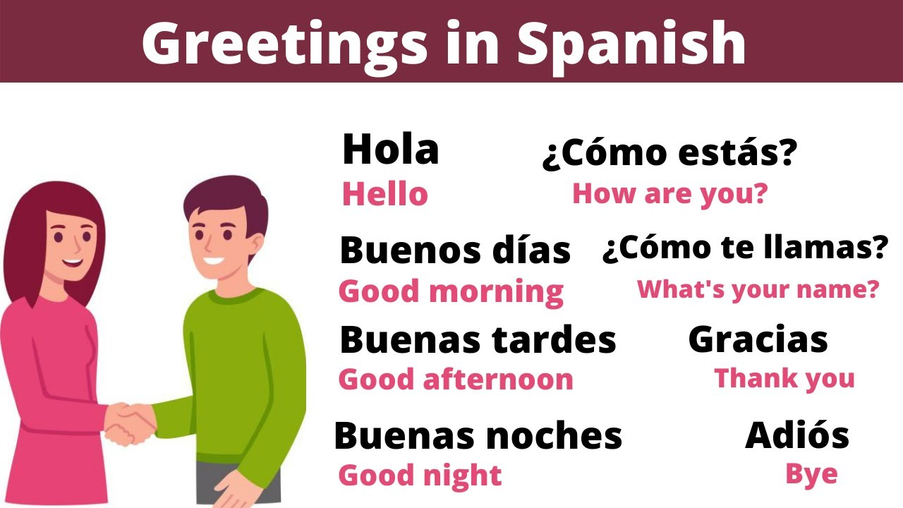
Greetings and Goodbyes
Greetings:
Hola (Hello)
Buenos días (Good morning)
Buenas tardes (Good afternoon)
Buenas noches (Good evening/night)
Goodbyes:
Adiós (Goodbye)
Hasta luego (See you later)
Hasta mañana (See you tomorrow)
Chao (Informal goodbye)
Practice: Greet your classmate in Spanish!

Slide 15
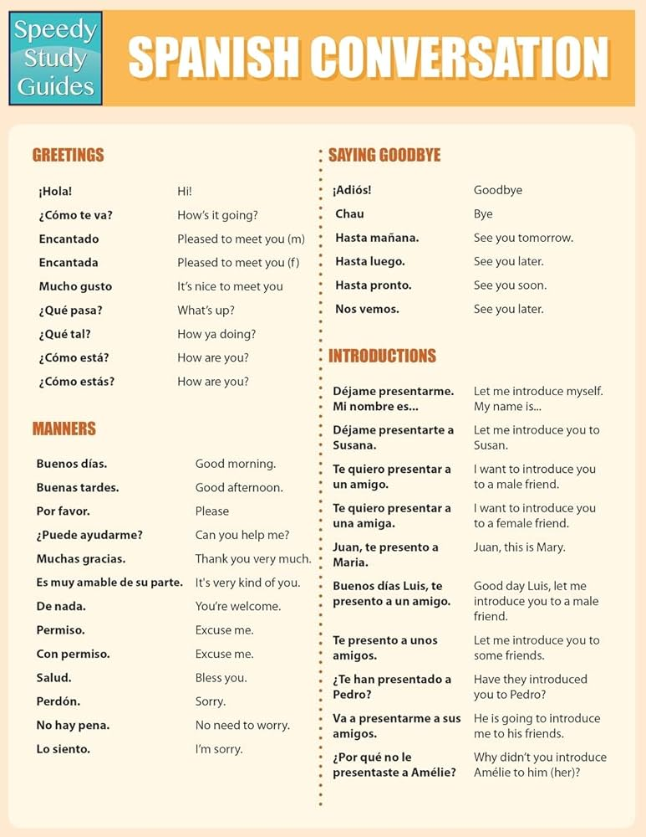
How Are You Doing?
¿Cómo estás? (How are you? - informal)
¿Cómo está usted? (How are you? - formal)
Common responses:
Bien, gracias (Fine, thank you)
Muy bien (Very well)
Así así (So-so)
Mal (Bad)
Always polite to ask back: "¿Y tú?" (And you?)
Role-play: Practice asking and answering with a partner

Slide 16
Introductions in Spanish
Me llamo... (My name is...)
¿Cómo te llamas? (What's your name? - informal)
¿Cómo se llama usted? (What's your name? - formal)
Mucho gusto (Nice to meet you)
Soy de... (I'm from...)
¿De dónde eres? (Where are you from?)
Practice introducing yourself in Spanish to the class!

